Slide 1
Inversive Geometry
Math Club 2/14/2011

Slide 2
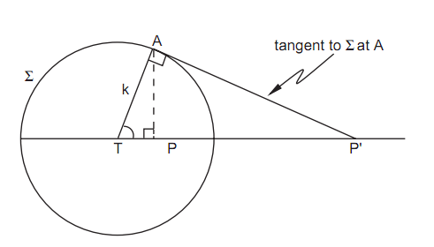
The inversion
The inversion is a transformation about a circle of radius $k$.
Basically the inversion turns the space inside out, so everything inside the circle goes outside and everything outside goes inside.
The closer a point is to the center, the farther away the inverse is.
The inverse of a point $P$ is the point $P′$ such that $\frac{TP}{k}=\frac{k}{TP′}$, or $TP⋅TP^{′}=k^{2}$.

Slide 3
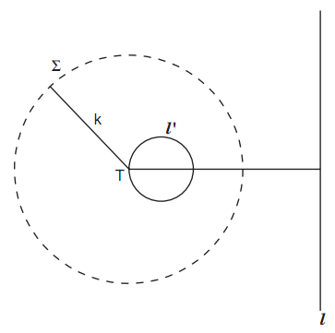
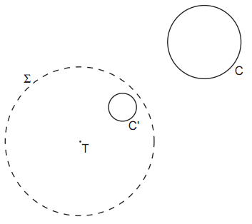
Basic Properties of the inversion
A line passing through $T$ inverts into itself.
A line not passing through $T$ inverts into a circle passing through $T$.
A circle passing through $T$ inverts into a line not passing through $T$.
A circle not passing through $T$ inverts into another circle.
I’m not going to prove all of these here.
Basically an inversion turns lines into circles and circles into lines.

Slide 4
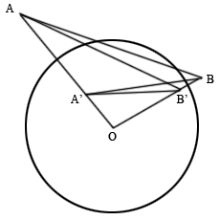
Inversion and similar triangles
An important property of the inversion is that angles are preserved (to an extent).
Here $OA⋅OA^{′}=k^{2}$ and $OB⋅OB^{′}=k^{2}$ so $\frac{OA}{OB}=\frac{OB^{′}}{OA^{′}}$.
Thus triangles $OAB$ and $OB^{′}A′$ are similar. We have $∠OAB=∠OB^{′}A′$.
The ratio of similarity, or $\frac{OB′}{OA}$ is $\frac{k^{2}}{OB⋅OA}$. Thus $A^{′}B^{′}=\frac{k^{2}AB}{OA⋅OB}$.

Slide 5
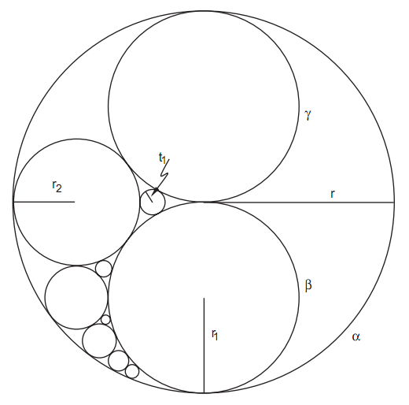
Really easy problem #1
Proposed by Hotta Jinsuke (Japan), 1788

Slide 6
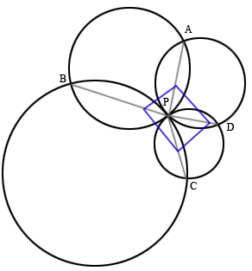
Really easy problem #2
International Mathematical Olympiad 2003 Shortlist (G4)
Let $Γ_{1}$, $Γ_{2}$, $Γ_{3}$, $Γ_{4}$ be distinct circles such that $Γ_{1}$, $Γ_{3}$ are externally tangent at $P$, and $Γ_{2}$, $Γ_{4}$ are externally tangent at the same point $P$. Suppose the circles intersect at four distinct points $A,B,C,D$. Then prove that $\frac{AB⋅BC}{AD⋅DC}=\frac{PB^{2}}{PD^{2}}$.

Slide 7
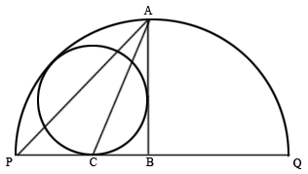
Really easy problem #3
Israeli Mathematical Olympiad 1995
$PQ$ is the diameter of a semicircle. A circle is tangent to the semicircle and tangent to $PQ$ at $C$. $AB$ is perpendicular to $PQ$ and is tangent to the circle; it intersects the semicircle at $A$ and $PQ$ at $B$. Prove that $AC$ bisects $∠PAB$.

